Slide 1
STAR WARS: THE ANALYSTS STRIKE BACK
Caden Emerson, Cole Bruss, Braxton Tittsworth, and Jessica Kirshner

Slide 2
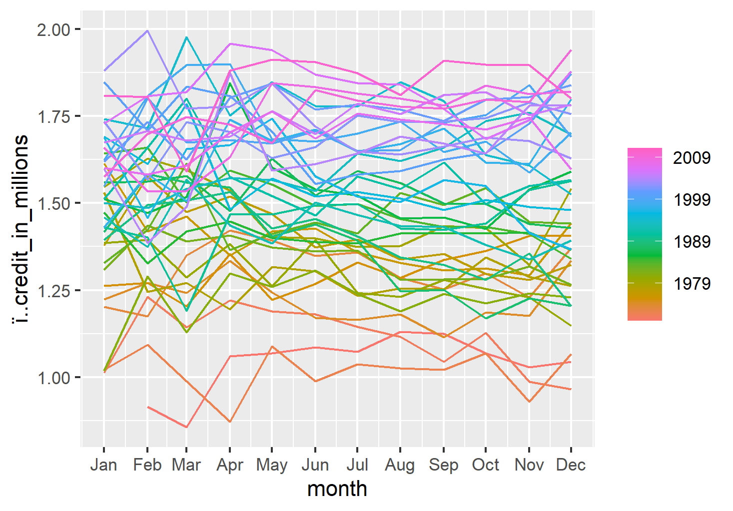
Seasonality
Not in this Galaxy
We investigated into seasonality more.
We can tell from the lack of patterns that there is no impact on Imperial Credit season to season.

Slide 3
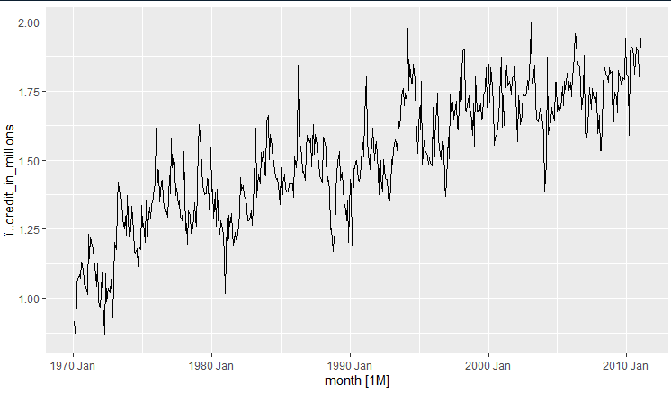
Original Series
We see an upward trend in the data with non-constant variation.

Slide 4
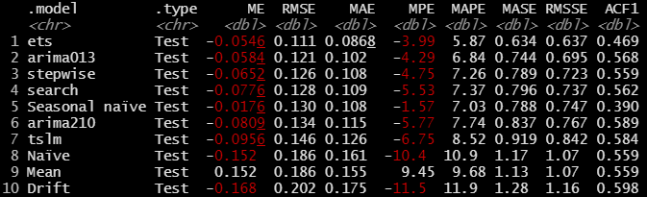
Models Tested
We decided to test and compare multiple models when it came to predicting the next 12 intervals.
According to our test, ETS was our best model with the lowest RMSE of 0.111! Following behind ETS, the next best models were ARIMA and then Stepwise.

Slide 5
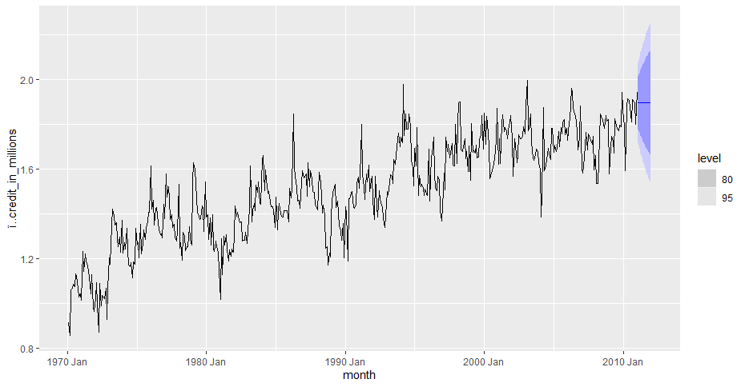
WHOA!
After deciding that ETS was the best tool for the job, we placed our predictions in for the next 12 intervals.

Slide 6
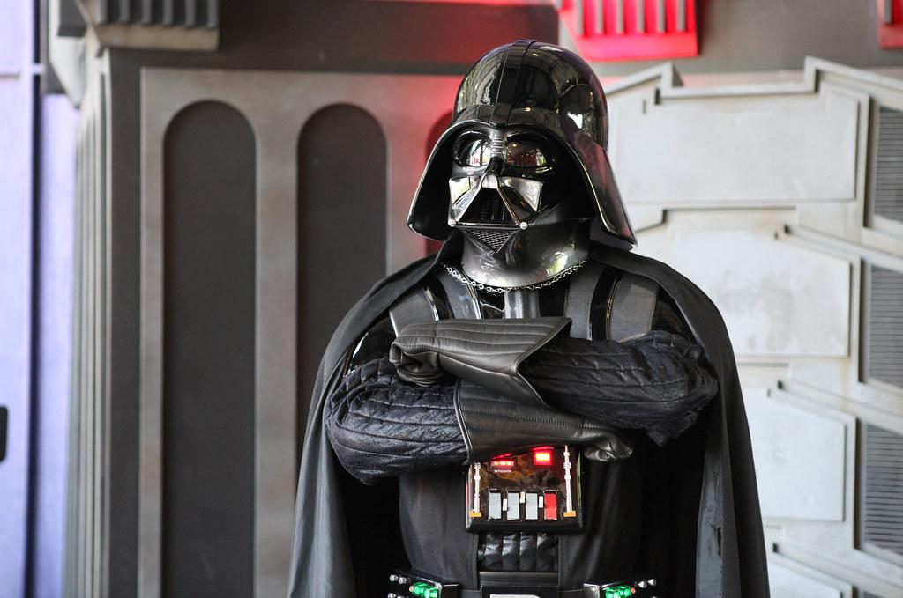
THE END.

